Slide 1
Social Media and Web Analytics
Social Media Analytics

Slide 2


Slide 3
Unstructured Data: Example
This review is based upon consistency of flavor and great customer service. We came and there was an unknown issue that required a 25 minute wait for food. The employee notified us, and although hesitant, we decided to stay. We have been here numerous times before in the past years so we are familiar with this location. The employee was apologetic and gave us a free drink. That was a simple gesture but rarely do you see decent customer service anymore. We received our food and had an issue with an incorrect order. It was explained and the issue was resolved quickly. They gave us a free appetizer. We do not expect perfection, nor free food. This restaurant cares for customers and works to provide a positive experience. We would return again because they have good food and they care. That is a rarity in today's restaurant culture. Kudos to the manager for creating this culture. Ordered- fried rive and Tofu, edamame, won ton soup, dynamite chx, and Thai curry chx

Slide 4
The Bag of Words Representation

Slide 5


The bag of words representation
seen | 2
sweet | 1
whimsical | 1
recommend | 1
happy | 1
... | ...
γ(
)=c

Slide 6
Sentiment Analysis using Reviews
2,000 restaurant reviews from Yelp
See the excel file “S1 Yelp_data.xls”
Business info, reviewer ID, review text, star rating and other covariates

Slide 7
Lots of information but it is unstructured
“Stayed here for two nights, costs was £109 per night for two people sharing a room which was not a budget price for what felt like budget rooms. Firstly they don't have any twin rooms in the hotel which would be preferable when I was sharing with a friend not my lover! There is only one small bin which is located in the bathroom. No soap, which I find ridiculous, only toiletries were a dual shower gel/hair wash. There was a hairdryer but no wardrobes or drawers. Room was also very cold. Now for the positive, the location is very good, close to princes street and St. Andrews square. The staff are very helpful and the bar is 24 hours. Don't bother with the breakfast which is £9.50 each for a continental breakfast where you can easily get a cooked breakfast in any one of the cafes in Cockburn Street, which is adjacent to this hotel. If I go to Edinburgh again I will book a different hotel.”

Slide 8
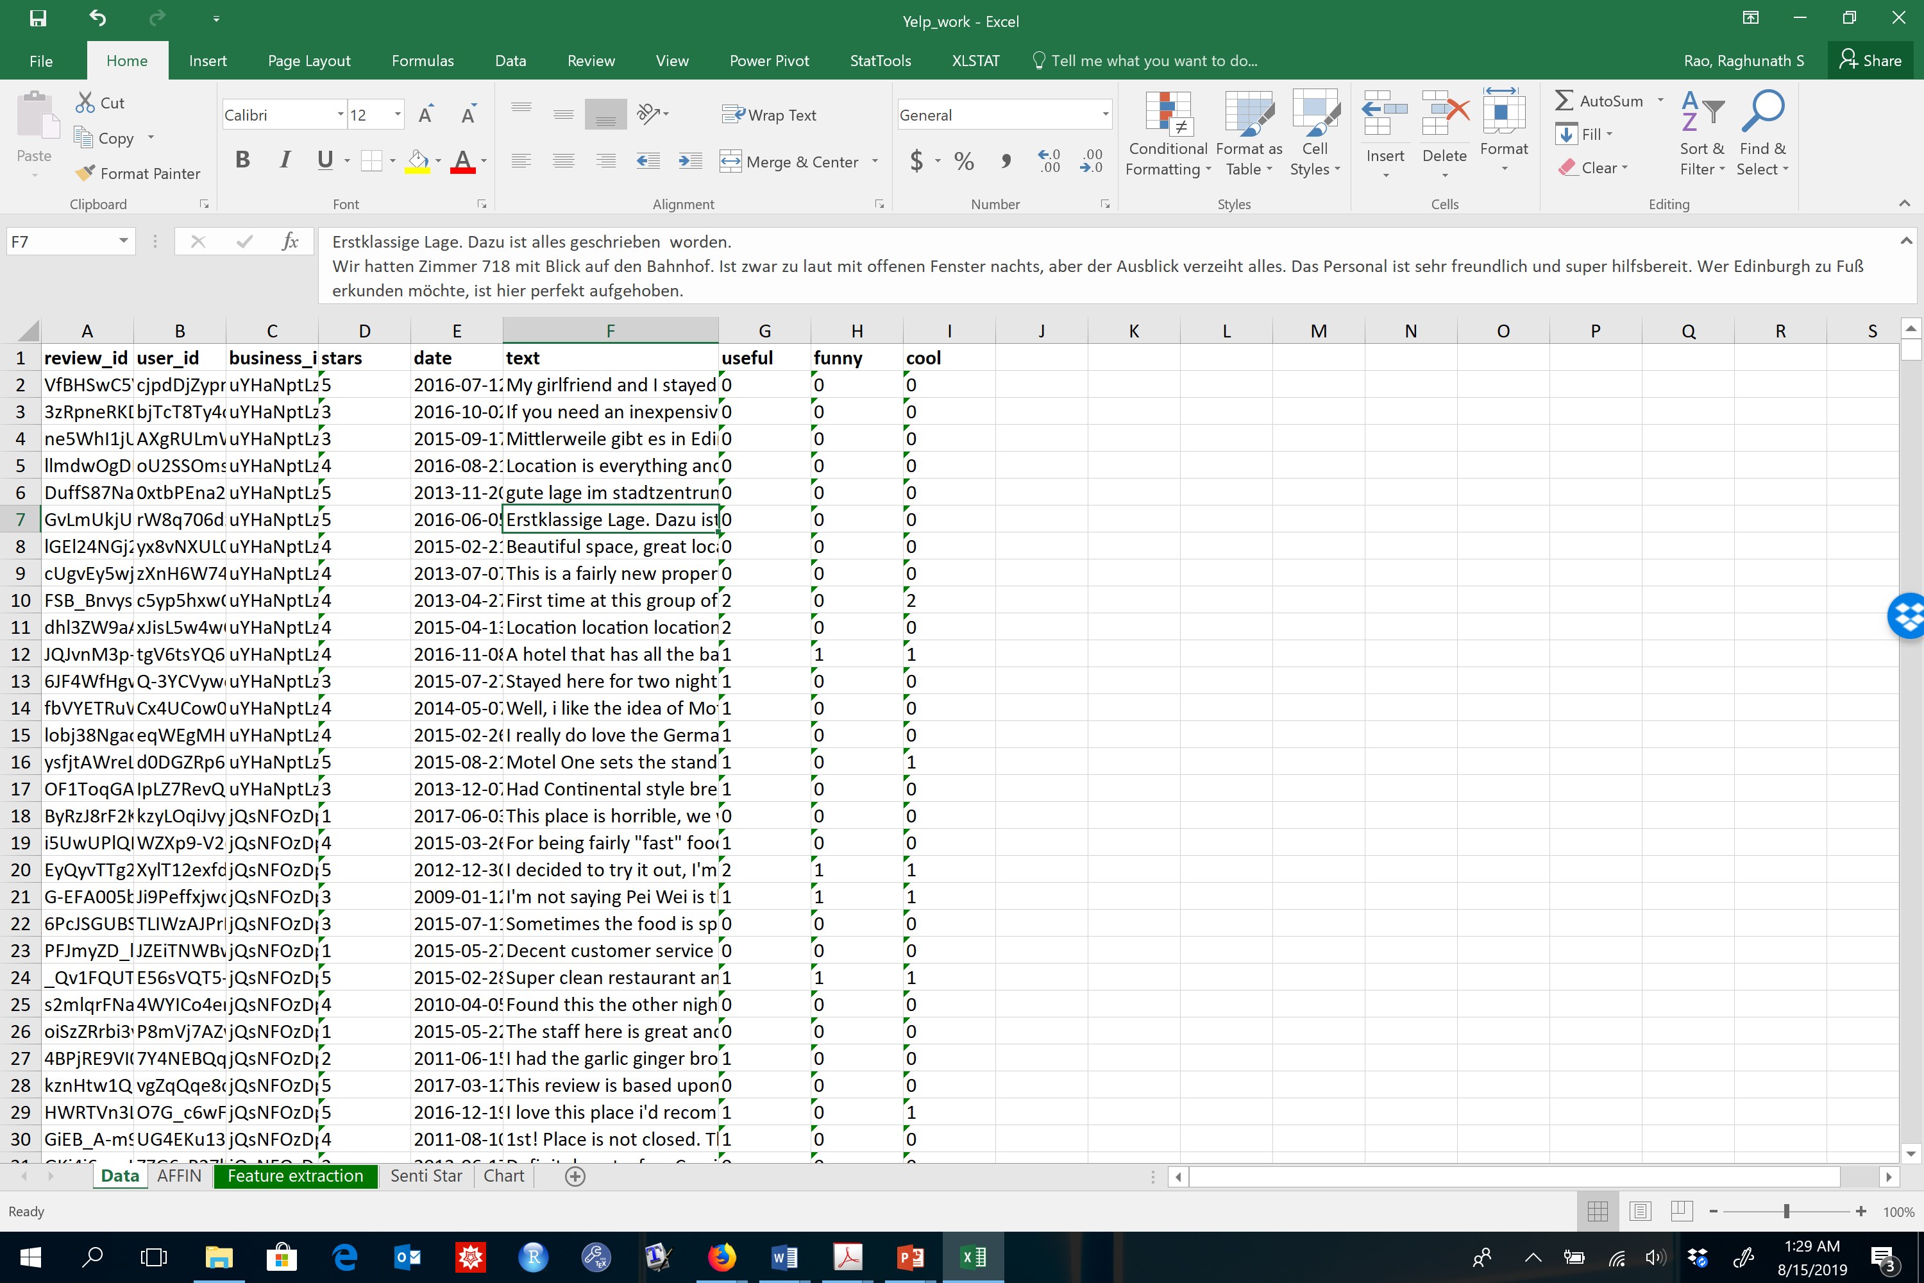
Data

Slide 9
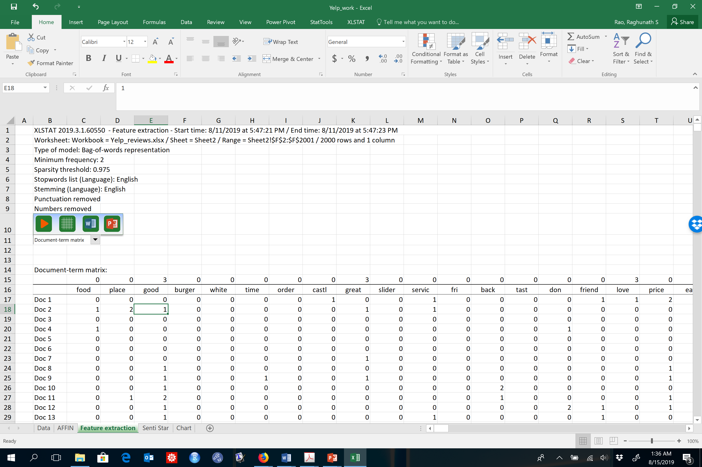
Step 1: Feature Extraction

Slide 10
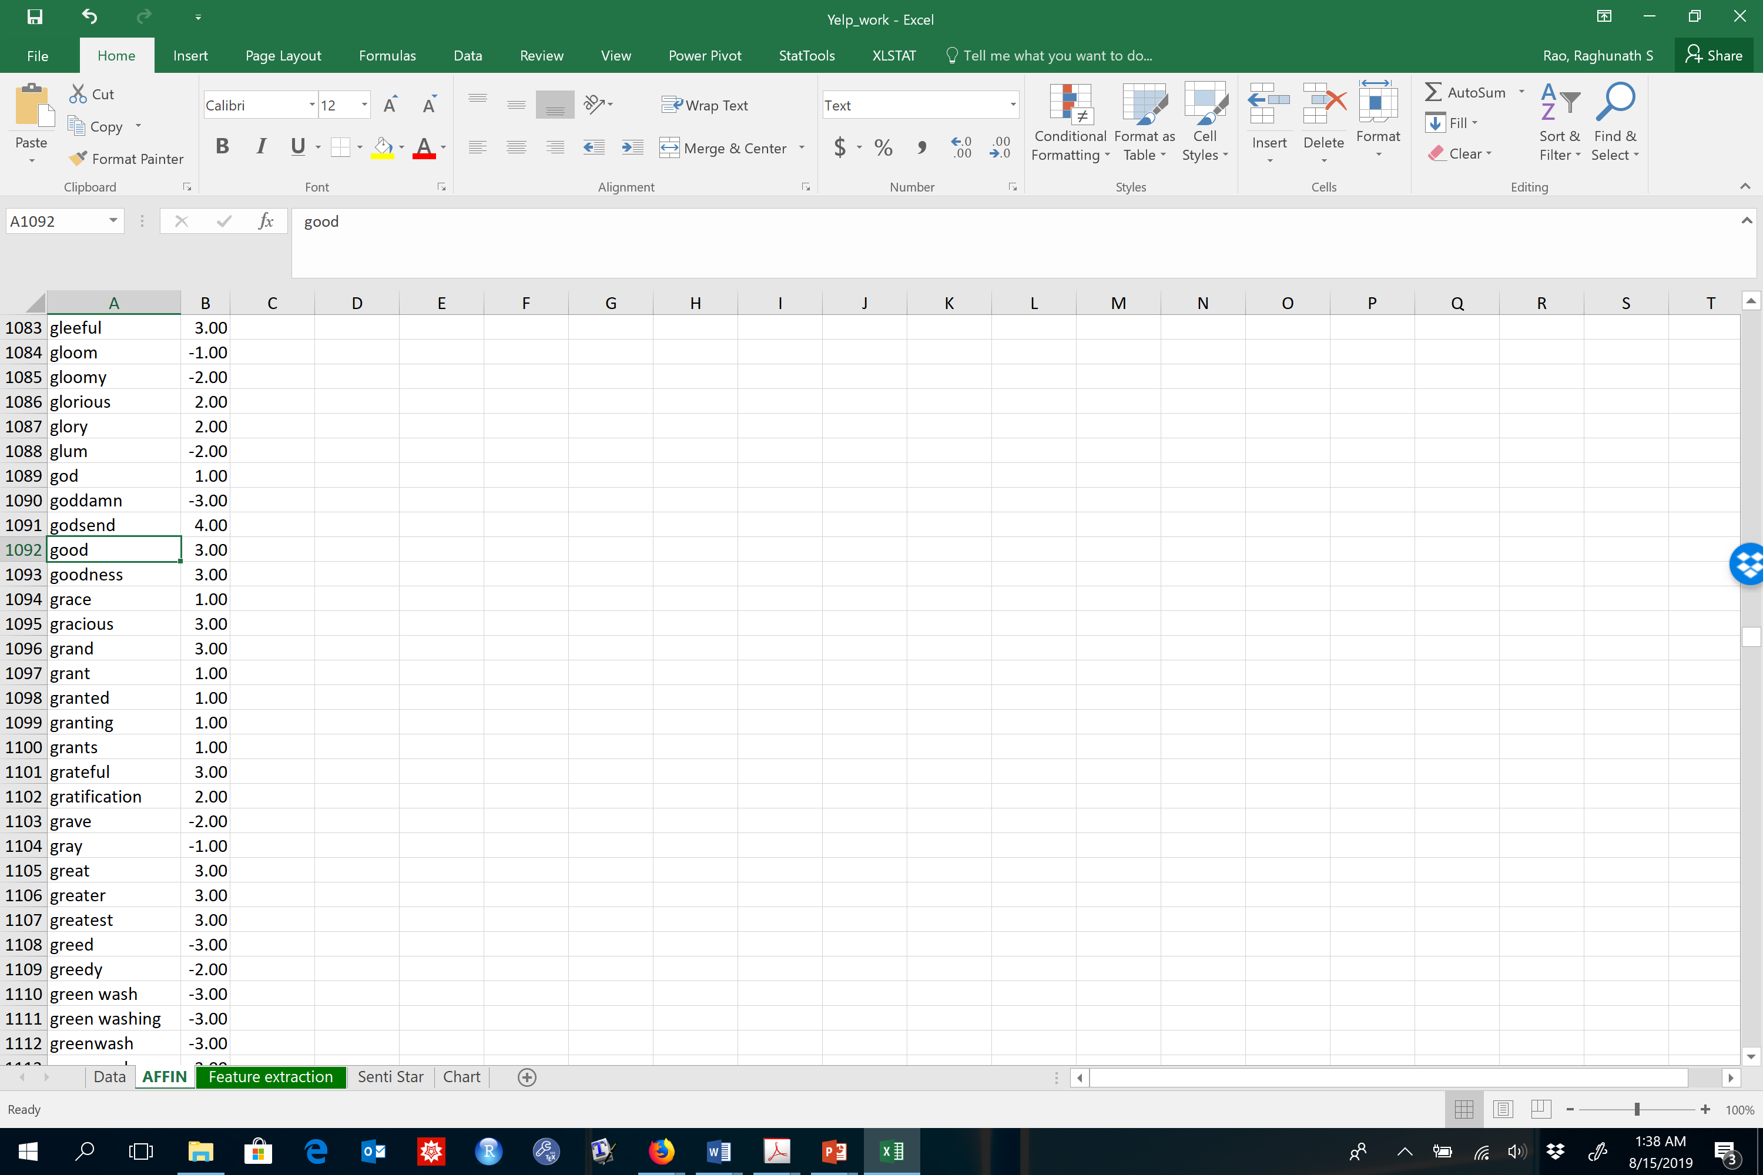
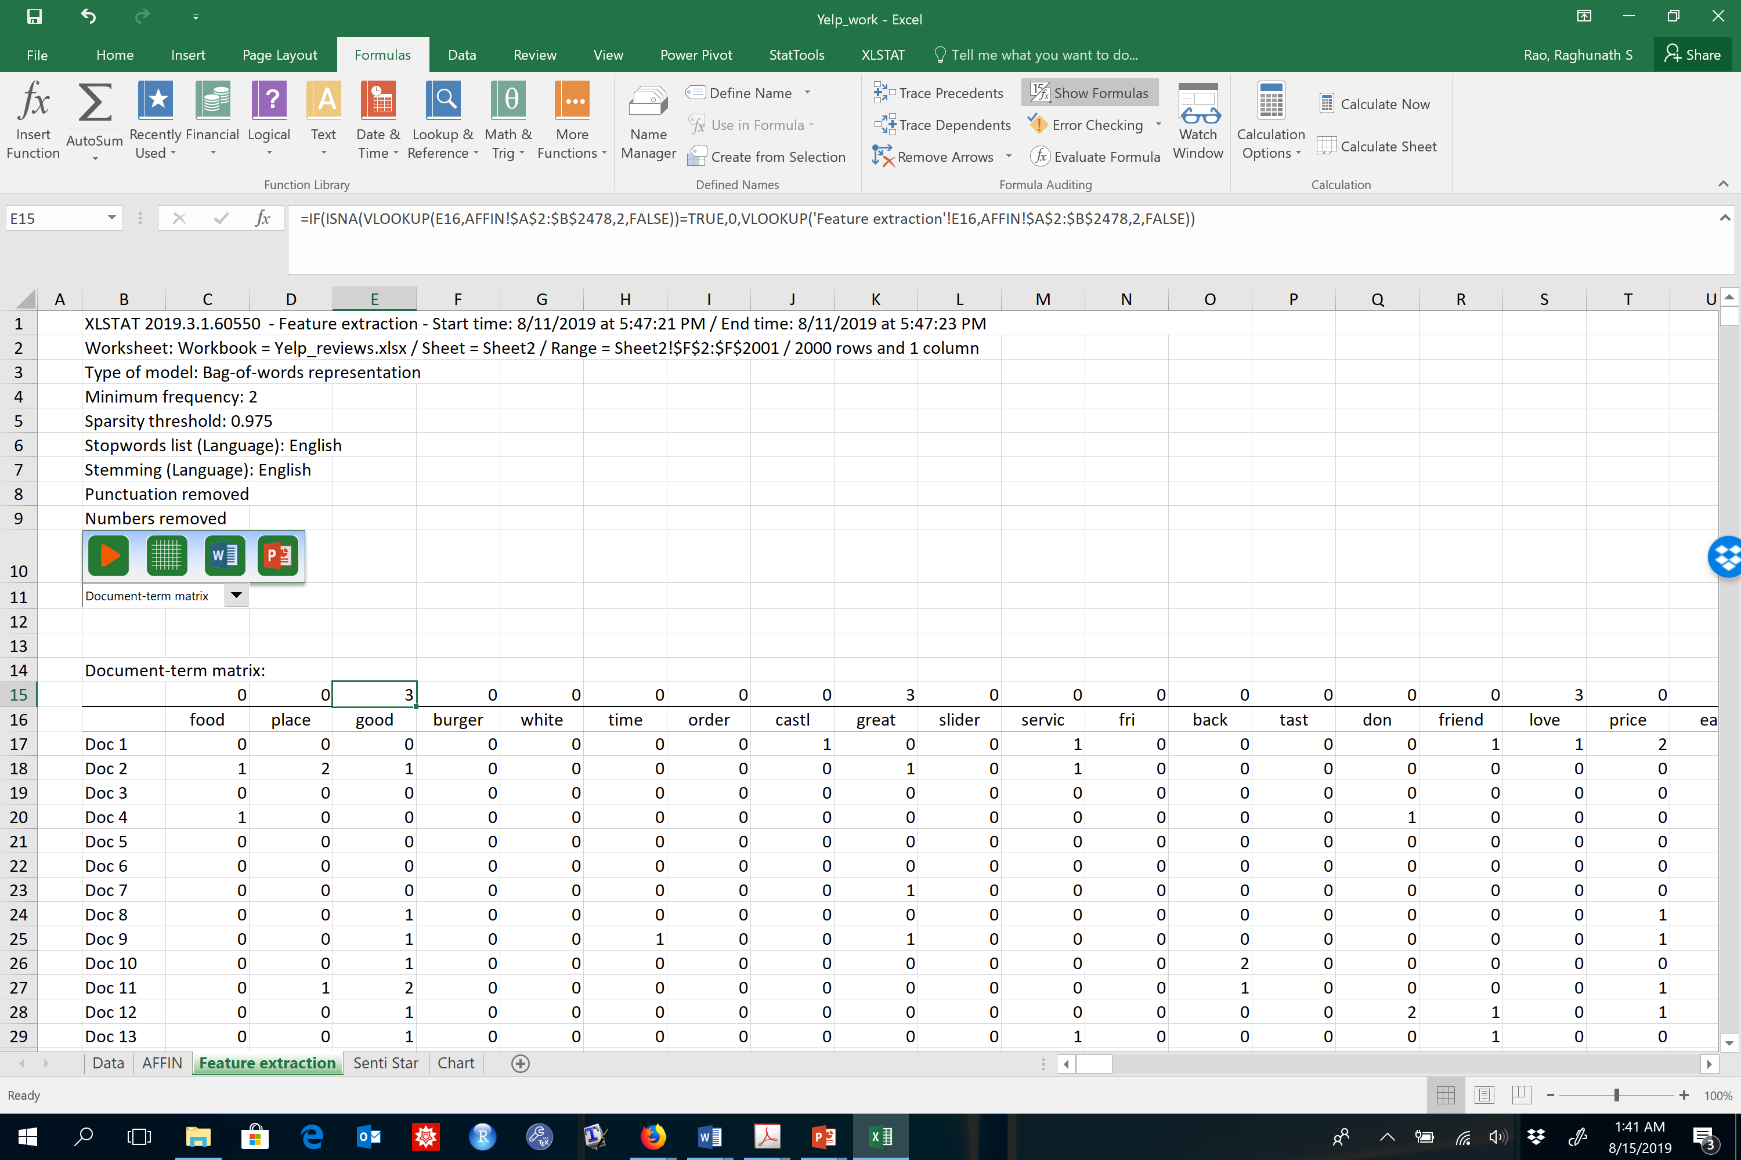
Step 2: Looking up the valence of each feature/token

Slide 11
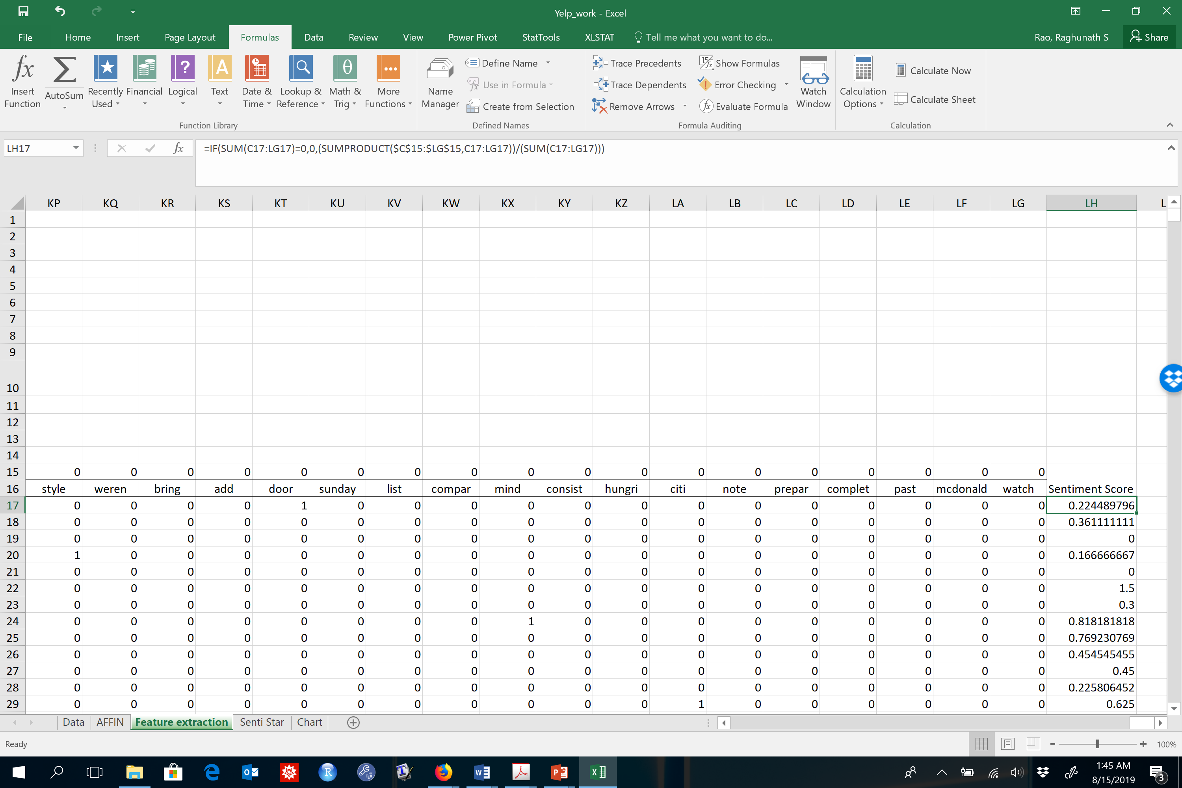
Step 3: Calculating the “Sentiment Score” of each review

Slide 12
So what do these sentiment scores mean?
Yelp reviews have both structured (“stars”) and unstructured (review text) features
Are they correlated?

Slide 13
Stars vs. Sentiment Scores!

Slide 14
Potential Applications of Sentiment Analysis
Can investor chatter predict share prices?
Can blogs and tweets about movies predict box office ratings?
Can companies design better products and services using online conversations?
And many more….

Slide 15
Application: Airline Customer Satisfaction
Every year, airlines closely follow American Customer Satisfaction Index (ASCI)
The ACSI has over two decades of experience analyzing passenger satisfaction with the largest airlines operating in the U.S.
Each year, the ACSI interviews hundreds of passengers about their recent flight experiences about:
Flight schedule options
Ease of reservations
Check-In process
Boarding process
On-Time arrival
Baggage handling
Loyalty programs
Gate staff courtesy and helpfulness
Flight crew courtesy and helpfulness
In-Flight entertainment
In-Flight complimentary food and beverages
In-Flight premium (purchased) food and beverages
Overhead storage
Cabin and lavatory cleanliness
Seat comfort
Quality of mobile app
Reliability of mobile app
Call center
Website

Slide 16
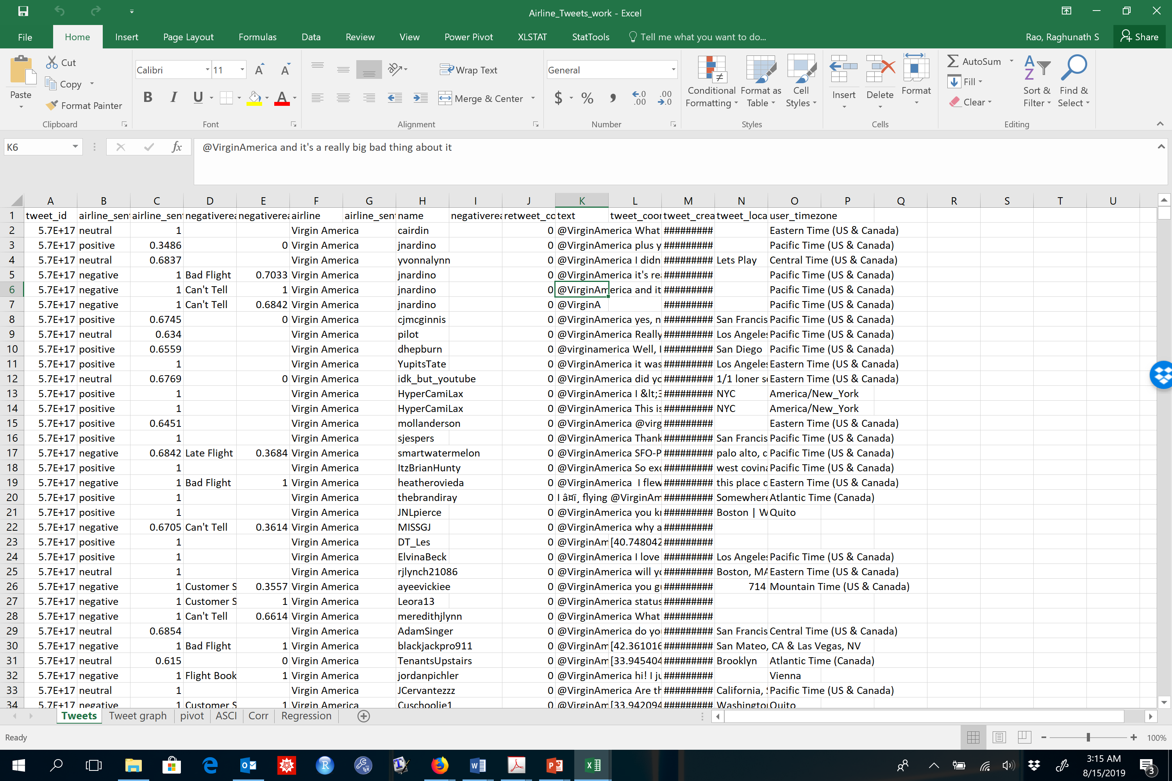
Twitter Data about Airlines: Scrapped in Feb 2015
Tweets and
Sentiment data
Airlines_tweet_data.xls

Slide 17
Data in Pictures

Slide 18
Simplest Possible Sentiment Score
# Positives MINUS #Negatives
 | American | Delta | Southwest | United
negative | 1960 | 955 | 1186 | 2633
neutral | 463 | 723 | 664 | 697
positive | 336 | 544 | 570 | 492
Grand Total | 2759 | 2222 | 2420 | 3822
Sentiment | -1624 | -411 | -616 | -2141

Slide 19
ASCI vs. Sentiment Score
ASCI | Net Positive | ASCI Rank | Tweet Rank
66 | -1624 | 3 | 3
71 | -411 | 2 | 1
78 | -616 | 1 | 2
60 | -2141 | 4 | 4
Correlation of 0.88!!!

Slide 20
Sentiment Analysis: Warren Buffett’s Letters to Shareholders
Split a text document into a set of distinct words
For each word, determine whether it is positive, negative, or neutral
Net Sentiment Ratio:
(Number of Positive Words - Number of Negative Words) / (Number of Total Words)

Slide 21
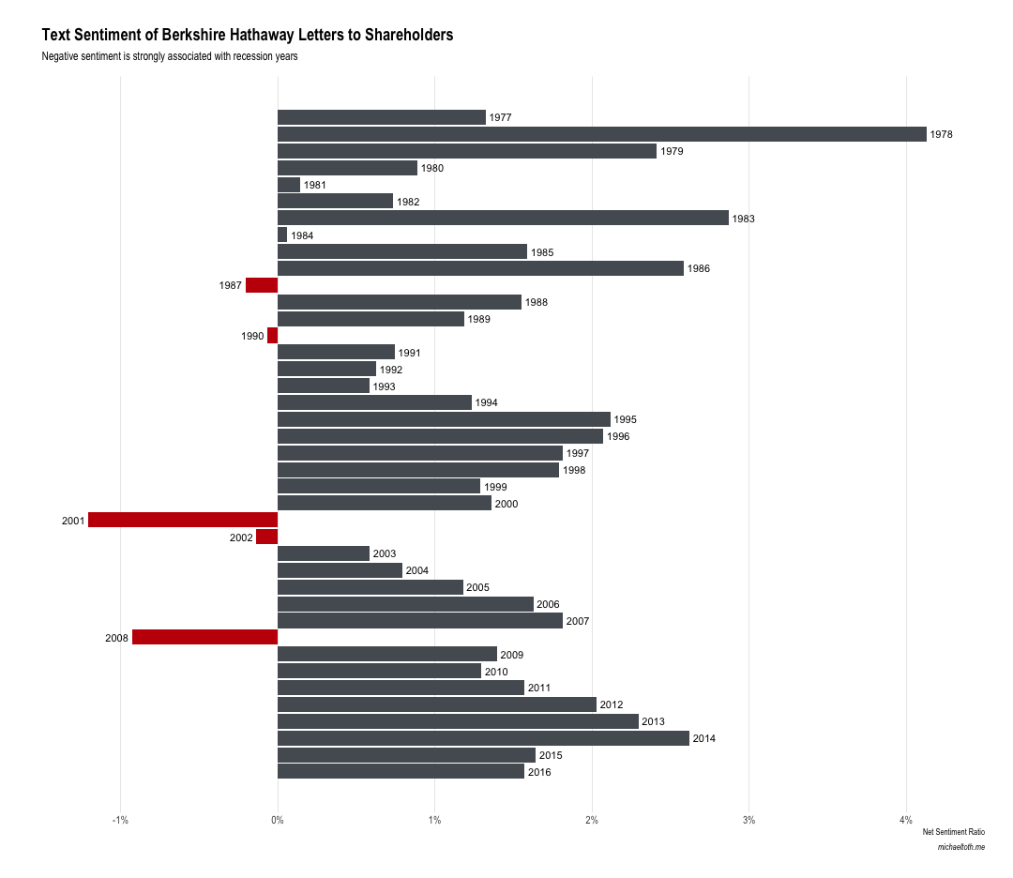
Warren is usually pretty upbeat!

Slide 22
What happened during the negative sentiment years?
1987: The market crash that happened on October 19th, 1987 (Black Monday) is widely known
as the largest single-day percentage decline ever experienced for the Dow-Jones Industrial Average, 22.61% in one day.
1990: The recession of 1990, triggered by an oil price shock following the United States' invasion of Kuwait,
resulted in a notable increase in unemployment.
2001: Following the 1990s, which represented the longest period of growth in American history,
2001 saw the collapse of the dot-com bubble and associated declining market values, as well as the September 11th attacks.
2002: The market, already falling in 2001, continued to see declines throughout much of 2002.
2008: You are not that young! -☺
https://blog.revolutionanalytics.com/2017/04/warren-buffet-sentiment.html

Slide 23
UGC
Calculating ROI of Social media (Kumar & Mirchandani)

Slide 24
A 7-step framework
Monitor Conversations
Identify Influential individuals
Identify factors shared by influencers
Locate potential influencers with relevant interest
Recruit those influencers
Incentivize Influencers
Reap Rewards

Slide 25
Calculating effect and value of social media influence
Customer Influence effect: Relative effect of an individual on another user or set of users
Stickiness Index: How specific the user is to a particular category of words and categories
Customer Influence Value: Monetary Gain or Social value from social media campaign
For further details: V. Kumar, Vikram Bhaskaran, Rohan Mirchandani, Milap Shah. 2013 Creating a Measurable Social Media Marketing Strategy: Increasing the Value and ROI of Intangibles and Tangibles for Hokey Pokey, Marketing Science,Vol 32, No.2

Slide 26
Process of measuring
User Data
Message Data
Organizational Data
User network data
User message
data
Global message data
Influencibility Ratio
Customer
Contribution Margin
Stickiness Index (SI)
Influence between user pairs
Does a WOM channel exist?
Is the WOM instance received?
Is the instance spread further?
CIE
CIV
CLV

Slide 27
Four Ideal characteristics of Influencers
Activeness: Number of times the influencer and their network “see” and “share”
Clout: Number of connections and followers an influencer has
Talkativeness of receiver: How often are messages being retweeted or shared
Likemindedness: Similarities between influencer and their network

Slide 28
In Class Session
Let us do some listening and social media analysis

